Slide 1
Developing Web-Applications with Node.js

Slide 2
About me | Shahar Solomianik
Language | PowerBuilder | Java | PHP | JavaScript | TypeScript
Server | WindowsNT | J2EE | Apache/lighty | Node.js/express | Nest.js
Database | SQLAnywhere | Oracle | MySQL | MongoDB | Postgres
Platform | Client/Server | Dedicated Server | AWS | Heroku | K8s/docker/ microservices/faas
 | 1997 | 1999 | 2004 | 2014 | 2019

Slide 3
Course Agenda
01
|
Introduction to Node.js
02
|
Asynchronous programming
03
|
File System Operations
04
|
Basic Web Server
05
|
External Modules (NPM)
06
Express web framework
|

Slide 4
Course Agenda
07
|
express Routing
express Input Validation
08
|
09
|
express Views
10
|
express Config
11
|
Working with MySQL
12
Working with MongoDB
|

Slide 5
Course Agenda
13
|
Authentication
14
|
Real Time apps
15
|
Testing
16
|
Deploying
17
|
Microservices
18
TypeScript
|

Slide 6
Samples Repository
https://github.com/shaharsol/jb-nodejs

Slide 7
01 | Introduction to Node.js

Slide 8
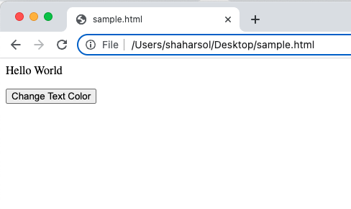
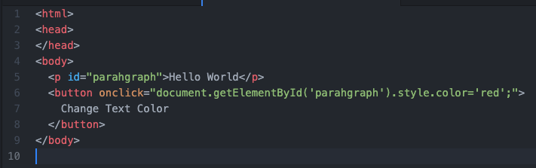
01 | Introduction to Node.js
The Javascript origin - the browser

Slide 9
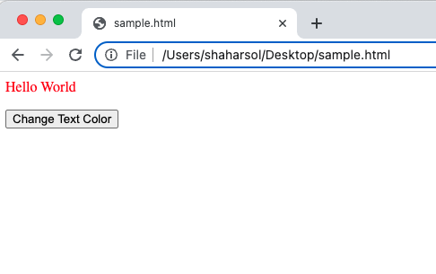
01 | Introduction to Node.js
The Javascript origin - the browser

Slide 10
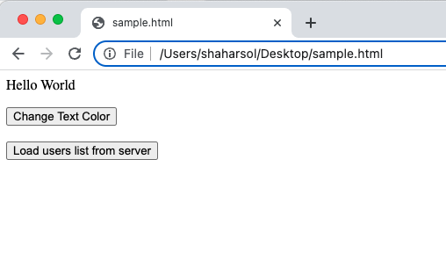
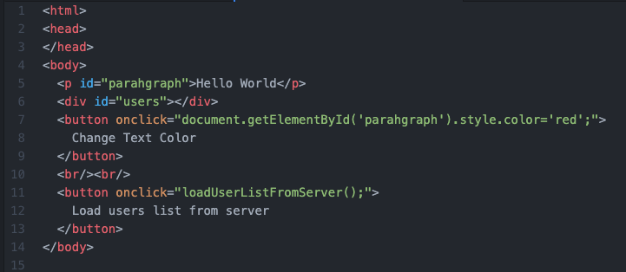
01 | Introduction to Node.js
The Javascript origin - the browser

Slide 11
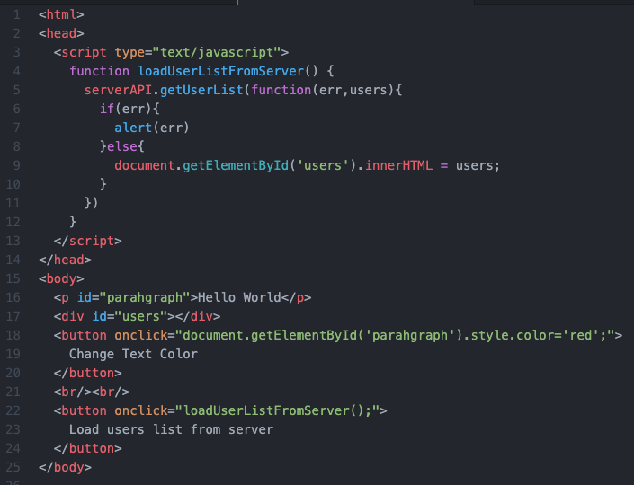
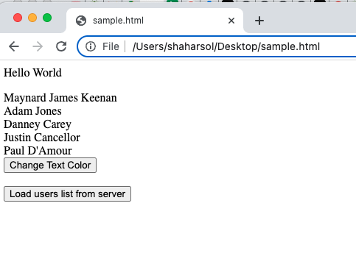
01 | Introduction to Node.js
The Javascript origin - the browser

Slide 12
01 | Introduction to Node.js
The Javascript origin - the browser

Slide 13

01 | Introduction to Node.js
2009. Internet gets big. Apache servers get slow.

Slide 14

01 | Introduction to Node.js
Ryan Dahl’s idea: Node.js

Slide 15
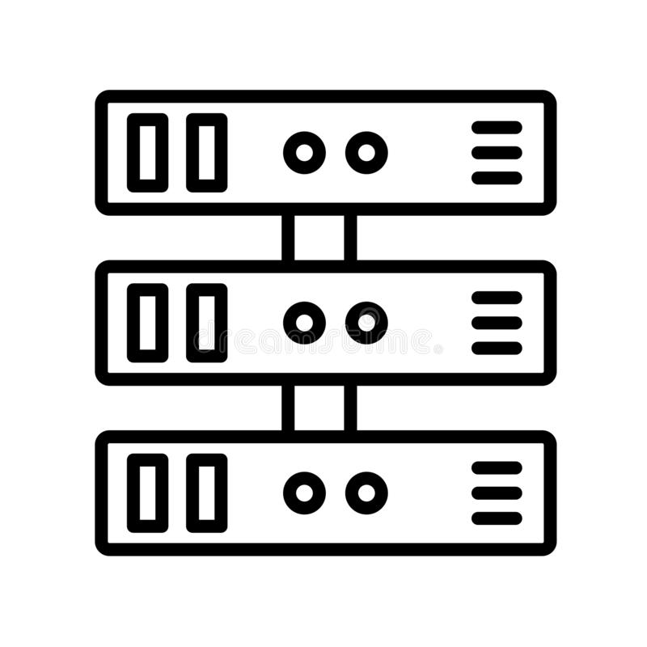
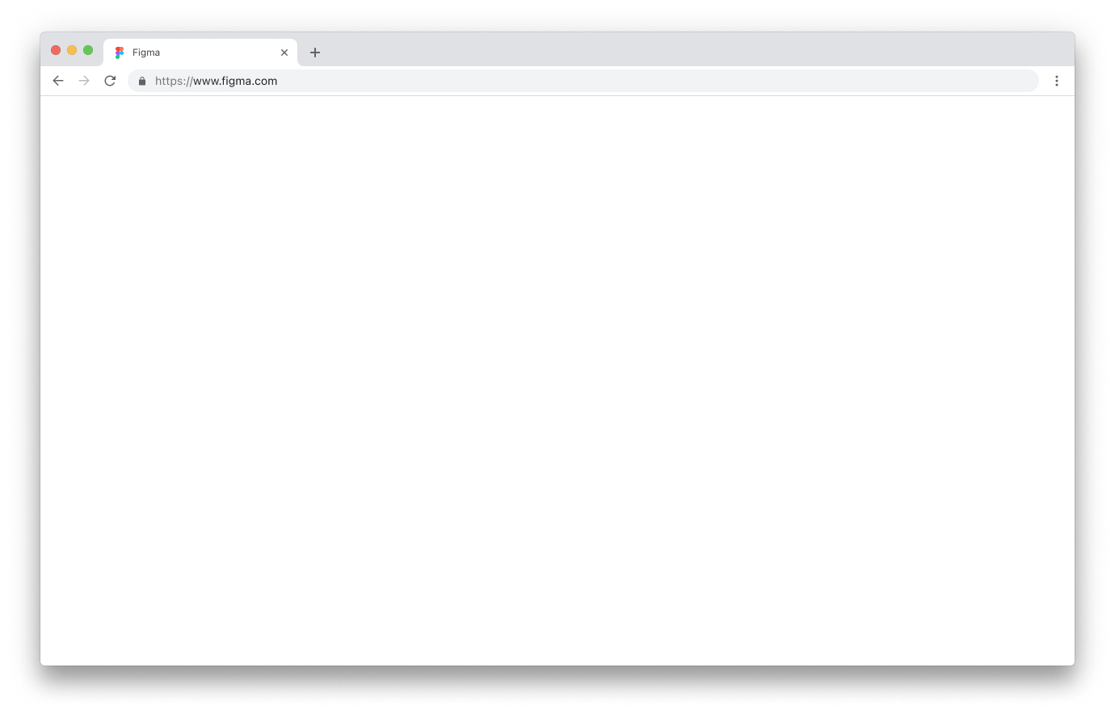

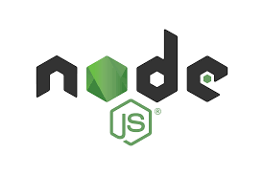
01 | Introduction to Node.js
Ryan Dahl’s idea: Node.js

Slide 16
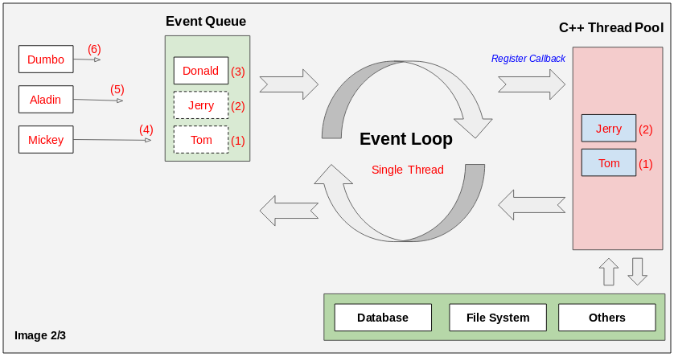
01 | Introduction to Node.js
Node.js Event Loop

Slide 17
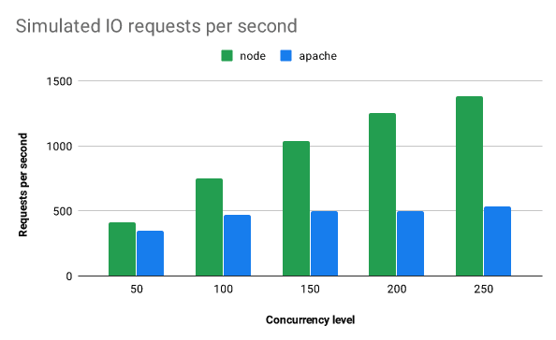
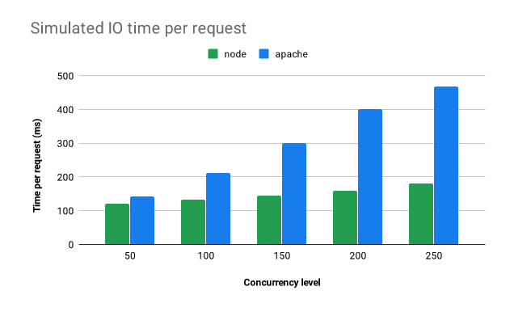
01 | Introduction to Node.js
Did it work? Hell yeah!

Slide 18
01 | Introduction to Node.js
Let’s play. What we need.
node
npm
nvm
npx

Slide 19
01 | Introduction to Node.js
Let’s play. What we need.
node –version
npm –version
nvm
nvm list
nvm install
nvm use
npx cowsay helloworld
a word about nodemon

Slide 20
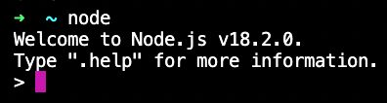
01 | Introduction to Node.js
Run node

Slide 21
01 | Introduction to Node.js
Run a node program
node {a .js file name}

Slide 22
01 | Introduction to Node.js
Debug a node program
default debugger
node inspect {a .js file name}
c
n
s
o
custom debug client
node –inspect {a .js file name}
normally your IDE will run this for you

Slide 23
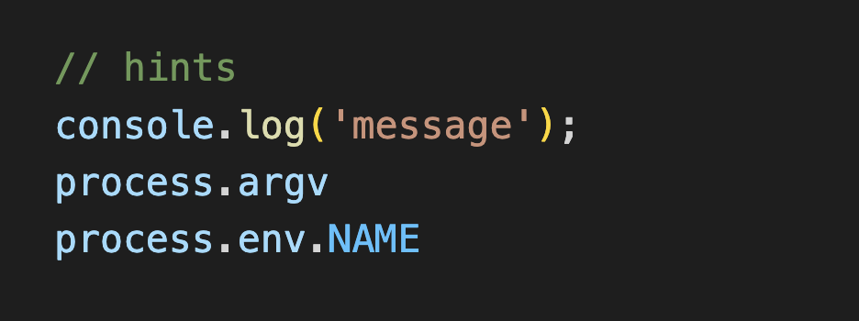
01 | Introduction to Node.js
Hello World Exercise(s)
Hello World
Hello {name} from params
Hello {name} from env
Templates Strings/String Interpolation - `Hello ${name}`

Slide 24
02 | Asynchronous Node.js

Slide 25
02 | Asynchronous Node.js
Three were given to the Elves

Slide 26
02 | Asynchronous Node.js
Remember the event loop?
Remember the browser callback example?

Slide 27
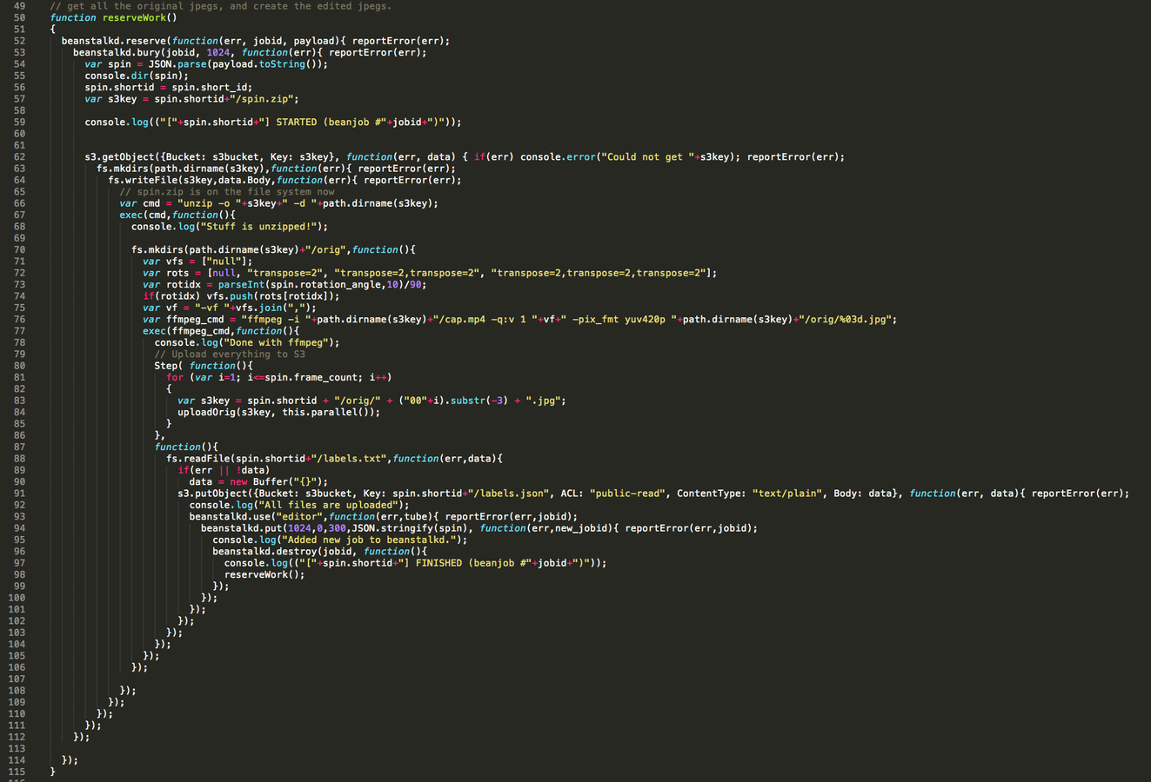
02 | Asynchronous Node.js
1st gen node code: Callback hell (real world example)

Slide 28
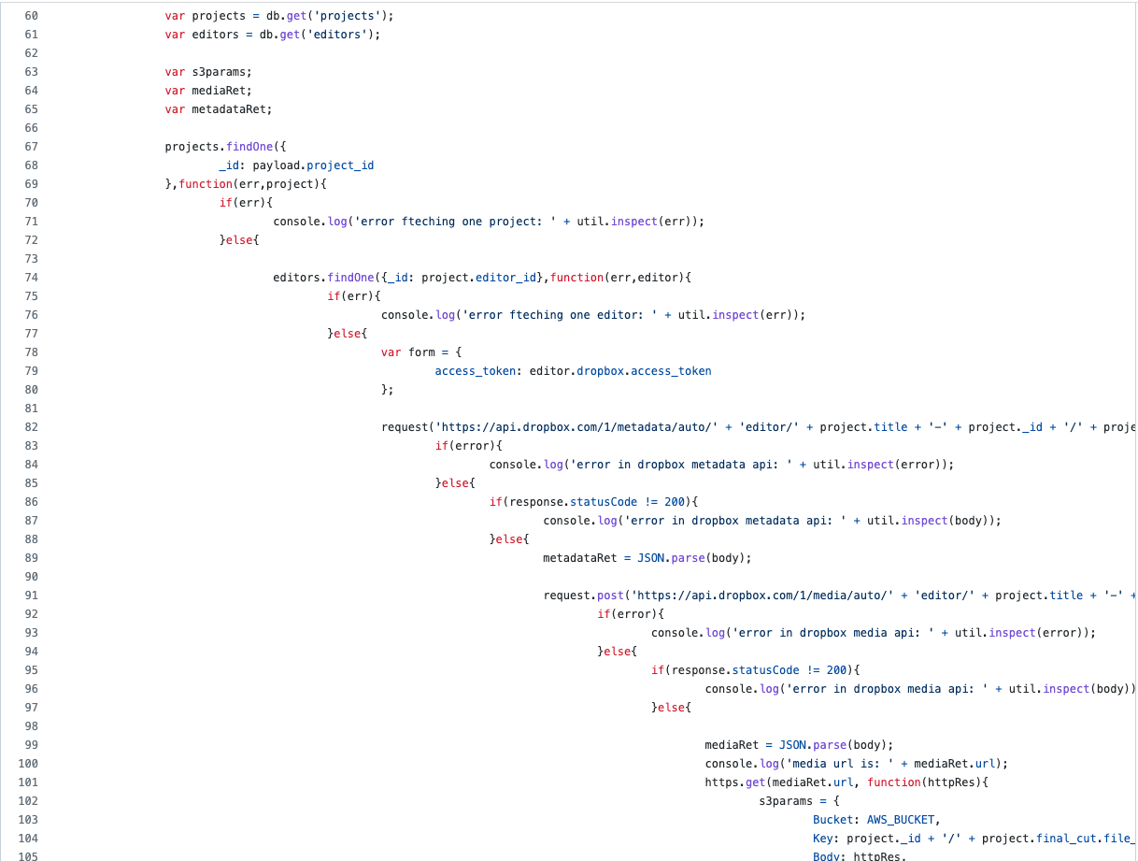
02 | Asynchronous Node.js
1st gen node code: Callback hell (real world example)

Slide 29
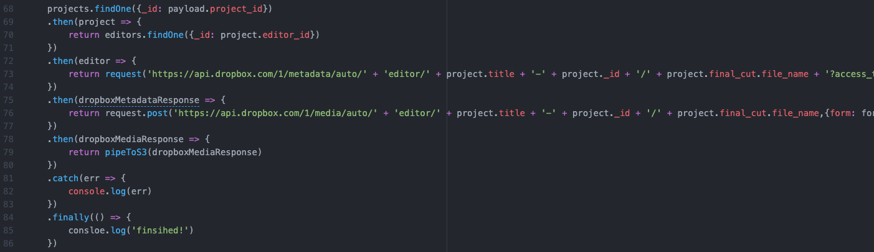
02 | Asynchronous Node.js
Same code implemented with Promises

Slide 30
02 | Asynchronous Node.js
What is a Promise?
The Promise object represents the eventual completion (or failure) of an asynchronous operation and its resulting value.

Slide 31
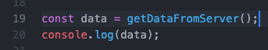
02 | Asynchronous Node.js
Basic Promise example

Slide 32
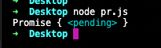
02 | Asynchronous Node.js
Basic Promise example

Slide 33
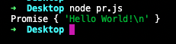
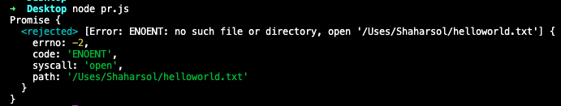
02 | Asynchronous Node.js
Promise statuses

Slide 34
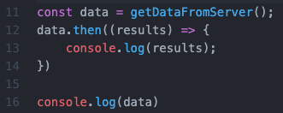
02 | Asynchronous Node.js
Basic Promise example

Slide 35
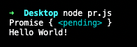
02 | Asynchronous Node.js
Basic Promise example

Slide 36
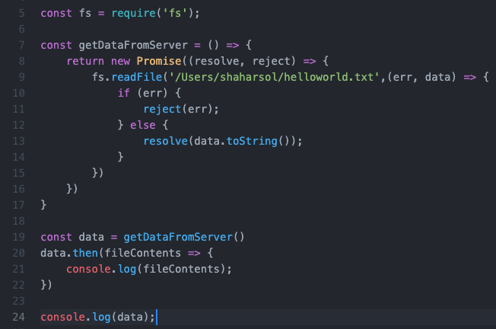
02 | Asynchronous Node.js
How did it work?

Slide 37
02 | Asynchronous Node.js
How did it work?

Slide 38
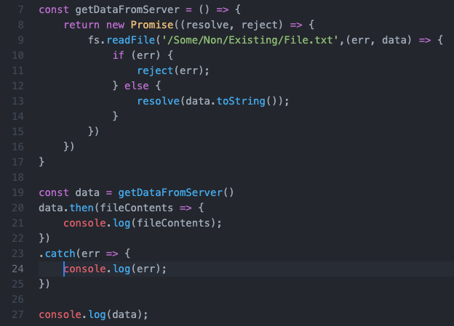
02 | Asynchronous Node.js
Promise rejection

Slide 39
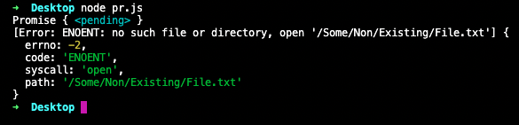
02 | Asynchronous Node.js
Promise rejection

Slide 40
02 | Asynchronous Node.js
Promise chaining

Slide 41
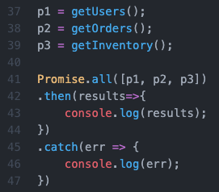
02 | Asynchronous Node.js
Promise concurrency

Slide 42
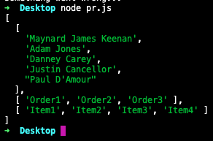
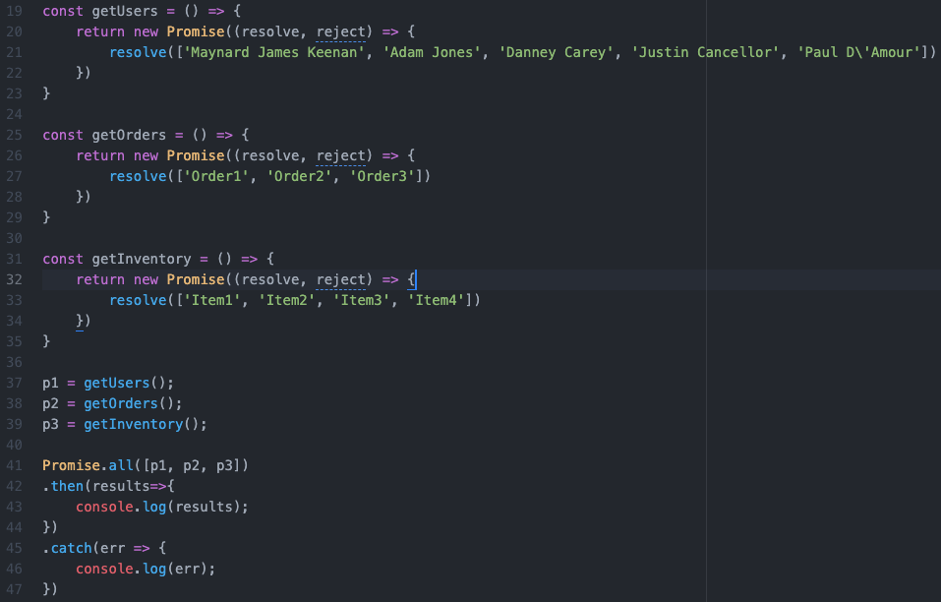
02 | Asynchronous Node.js
Promise concurrency

Slide 43
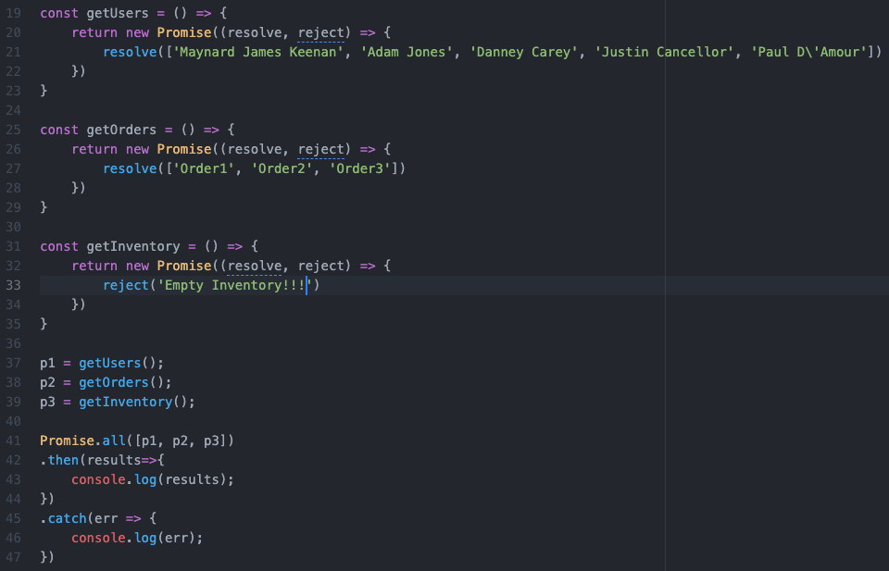
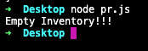
02 | Asynchronous Node.js
Promise concurrency

Slide 44
02 | Asynchronous Node.js
Promise.any() - fulfills when any of the input's promises fulfills, with this first fulfillment value. It rejects when all of the input's promises reject
Promise.allSettled() - fulfills when all of the input's promises settle (including when an empty iterable is passed), with an array of objects that describe the outcome of each promise.
Promise.race() - This returned promise settles with the eventual state of the first promise that settles.

Slide 45
02 | Asynchronous Node.js
ES2017: This is still not human readable

Slide 46
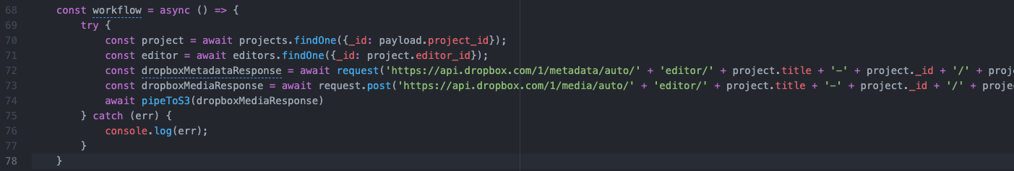
02 | Asynchronous Node.js
Async/await

Slide 47
02 | Asynchronous Node.js
Async/await

Slide 48
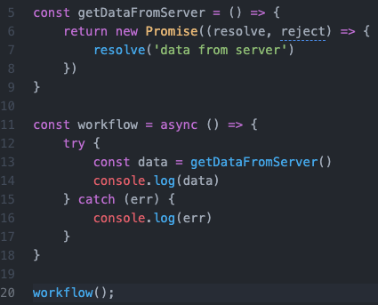
02 | Asynchronous Node.js
async/await example

Slide 49
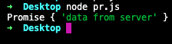
02 | Asynchronous Node.js
async/await example

Slide 50
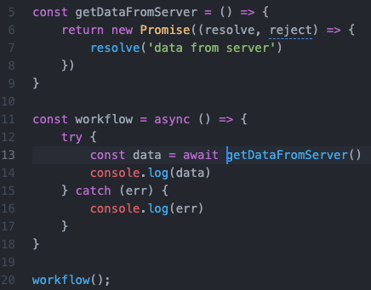
02 | Asynchronous Node.js
async/await example
Don’t forget to await…

Slide 51
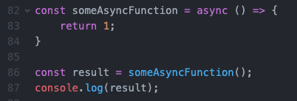
02 | Asynchronous Node.js
Async function return value

Slide 52
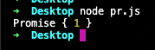
02 | Asynchronous Node.js
Async function return value

Slide 53
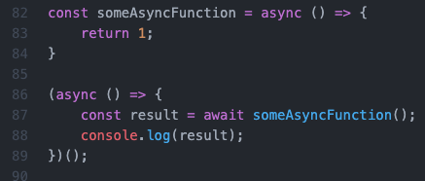
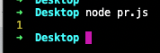
02 | Asynchronous Node.js
Async function return value is always a promise

Slide 54
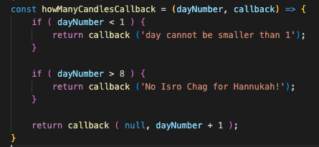
02 | Asynchronous Node.js
Async exercise - use this server-mock-function to calc how many candles are lit in Hanukkah, in 3 different ways…
using callbacks
using then
using async/await

Slide 55
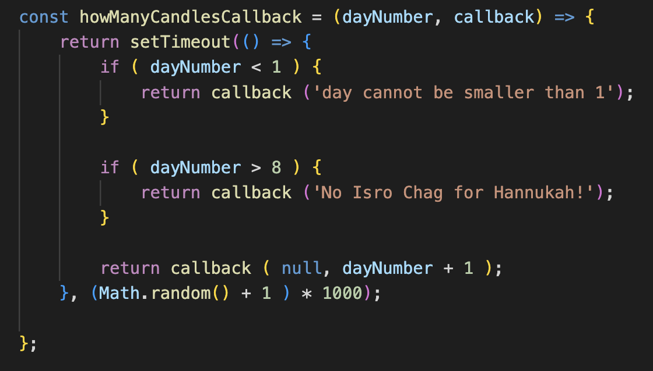
02 | Asynchronous Node.js
Async exercise - now use this more realistic server-mock-function and see if you were correct…

Slide 56
03 | File System with Node.js

Slide 57
03 | File System with Node.js
Now that we know how to work with async, let’s do some IO!

Slide 58
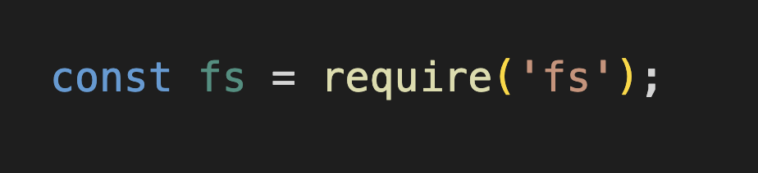
03 | File System with Node.js
Remember this? Node adds some essential built-in modules on top of native JavaScript

Slide 59
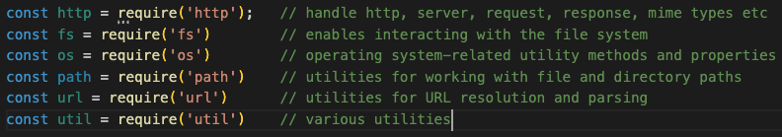
03 | File System with Node.js
Some other important node modules

Slide 60
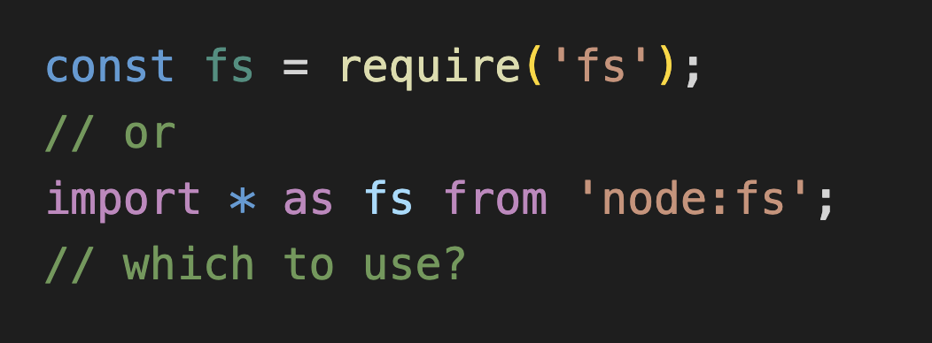
03 | File System with Node.js
We’ll use the fs node module

Slide 61
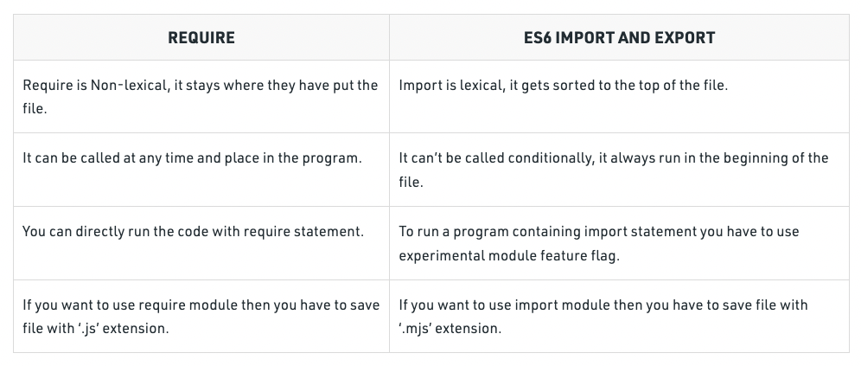
03 | File System with Node.js
We’ll use the fs node module

Slide 62
03 | File System with Node.js
For simplicity, we’ll stick with require for this course

Slide 63
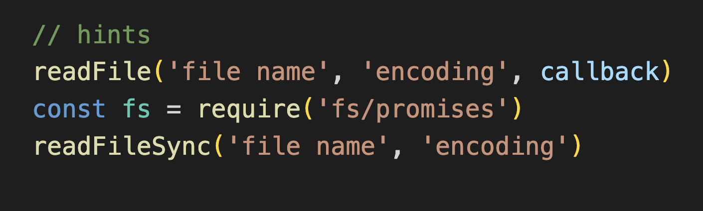
03 | File System with Node.js
Let’s read a local file contents
using readFile (callback)
using promises (with either then or async/await)
using readFileSync

Slide 64

03 | File System with Node.js
readFileSync is blocking!!!
all fs.xxxSync methods are blocking!!!
use only in CLI!!!

Slide 65
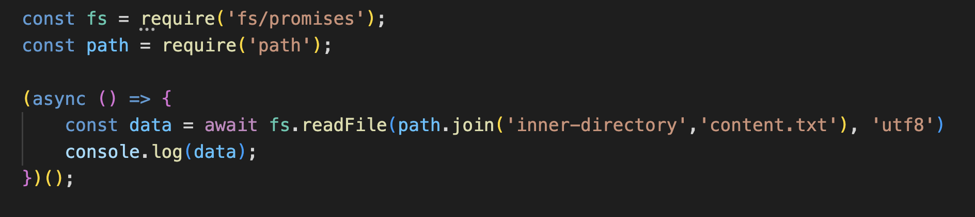
03 | File System with Node.js
use path module to be OS agnostic

Slide 66
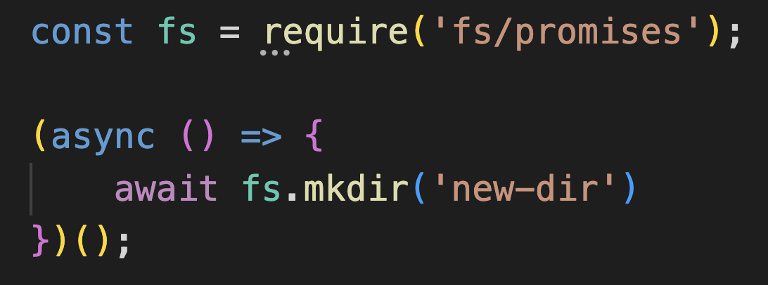
03 | File System with Node.js
create a directory

Slide 67
03 | File System with Node.js
Some more fs functions
chown
rmdir
unlink
etc… https://nodejs.org/api/fs.html

Slide 68
04 | Basic Web Server with Node.js

Slide 69
04 | Basic Web Server with Node.js
Now that we know how to work with async, and files… let’s build a web server!
But first, let’s have Postman installed.
postman = curl with GUI
easy manipulation of
verb
input
content type
presentation of
response
status

Slide 70
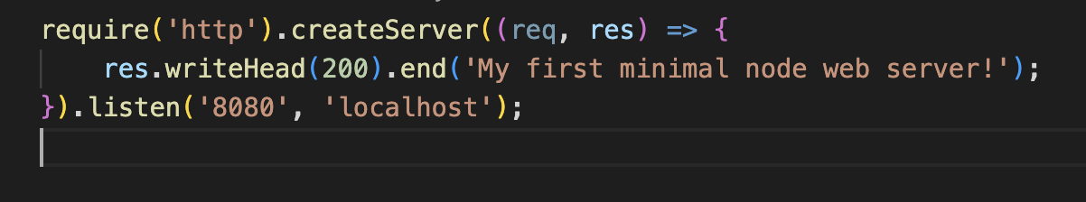
04 | Basic Web Server with Node.js
A minimal Node.js native web server

Slide 71

04 | Basic Web Server with Node.js
A minimal Node.js native web server

Slide 72

04 | Basic Web Server with Node.js
We can require only what we need (deconstruction)…

Slide 73
04 | Basic Web Server with Node.js
Which style do you prefer?

Slide 74

04 | Basic Web Server with Node.js
Let’s return a json object

Slide 75

04 | Basic Web Server with Node.js
Now let’s return CSV output

Slide 76

04 | Basic Web Server with Node.js
Now let’s return CSV file

Slide 77

04 | Basic Web Server with Node.js
Multi endpoints server
/age should return “age endpoint”
/name should return “name endpoint”
any other request should return 404

Slide 78
04 | Basic Web Server with Node.js
Multi endpoints/methods server
GET /age should return “age endpoint”
POST /name should return “name endpoint”
any other request should return 404

Slide 79

04 | Basic Web Server with Node.js
At this point, you should ask yourself
So our entire server is actually an requestListener huge function?
Don’t we have some framework to standardize and make sever development more streamlined?

Slide 80
05 | NPM

Slide 81


05 | NPM
External modules.

Slide 82

05 | NPM
Write a script that generates a 5 letters code for a bit.ly like system.
example: aSdTy

Slide 83

05 | NPM
The same with chance.js npm module:

Slide 84

05 | NPM
Native http GET:

Slide 85

05 | NPM
Axios npm module http GET:

Slide 86
05 | NPM
Conclusion:
npm modules come in very handy
1000s of modules for any niche requirement (explore https://npmjs.com )
use at own risk… ( e.g. https://therecord.media/malware-found-in-npm-package-with-millions-of-weekly-downloads )

Slide 87
05 | NPM
Installing npm modules:
globally: npm install -g [module name]
locally: cd into a directory and…
npm install [module name]
npm install –save [module name]
npm install –save-dev [module name]
look at package.json

Slide 88
05 | NPM
Some [of my] favorite modules
axios / node-fetch - http operations
config / dotenv - configuration
winston - logging (you don’t really console.log in prod…)
moment - date/time manipulation (deprecated, can use dayjs instead)
joi - input validation
aws-sdk - self explanatory…
express - the most popular nodejs server framework
nestjs - express successor for TypeScript (depends on express)

Slide 89

05 | NPM
Real world example

Slide 90

05 | NPM
NPM versioning

Slide 91
06 | express Framework

Slide 92

06 | express Framework
And now… express

Slide 93

06 | express Framework
express hello world

Slide 94

06 | express Framework
http verbs. Implement:
POST /user
DELETE /ticket
PATCH /employee
PUT /organization

Slide 95

06 | express Framework
Path params Implement:
POST /user/{id} (meaningless in reality…)
DELETE /ticket/{id}
PATCH /employee/{id}
PUT /organization/{id}

Slide 96

06 | express Framework
Query params. Implement:
GET /?id={whatever}
print {whatever}

Slide 97

06 | express Framework
post body. Implement:
POST / data ”id=whatever”
print {whatever}

Slide 98

06 | express Framework
Couldn’t find it, did ya?
It’s hidden somewhere in the stream…
urlencoded middleware to the rescue…

Slide 99

06 | express Framework
Middleware??? what is a middleware?

Slide 100
06 | express Framework
An express app is a collection of chained middlewares
middle - between request and response
cycle starts with incoming request
ends with response.send
anything in between is middleware
middleware has access to request, response, and next middleware
middleware order is important and sequential (determines next)
special middleware: error middleware, put those last…
can filter middlewares by path
better with Routers

Slide 101
06 | express Framework
some provided middlewares (by expressjs):
express.json (accept application/json)
express-session
cookie-parser
morgan (logging)
serve-static (serve static files - better use CDN though…)
more…

Slide 102

06 | express Framework
We can create our own middlewares

Slide 103

06 | express Framework
Exercise: create an auth middleware
request must have Authorization header
value structure: Bearer {token}
allow where token === ‘123’
respond with 401 otherwise
where is the right place for this middleware in the order?

Slide 104

06 | express Framework
Real world example: auth middleware for bearer token (oauth standard)

Slide 105

06 | express Framework
Exercise: create a middleware to log all incoming POST requests statuses.
Where should it be placed in the order? think carefully ;-)

Slide 106

06 | express Framework
Error middleware
gets 4 params (err, req, res, next)
invoked only by next(err) from another middleware
don’t forget to next(err) from your catch blocks!!!

Slide 107
06 | express Framework
Error middleware exercise:
enforce naive input validation
fail with 400 on error

Slide 108
06 | express Framework
Think: How to implement a 404 error handler?

Slide 109
06 | express Framework
Summary exercise:
create the following app:
auth with bearer 123
read users data from https://jsonplaceholder.typicode.com/users
filter out according to pagination params (e.g. 2,2)
return either json or XML depending on query string tag
allow only GET ‘/users’ endpoint
return 404 otherwise
example request: /?format=xml&offset=2&limit=2

Slide 110
0x | From here on, we’re building an app

Slide 111
0x | A crypto dashboard app
Enables users to monitor online rates of their favorite crypto coins.
usecases:
signup (using Github)
add symbol
monitor symbols

Slide 112
0x | A crypto dashboard app
views:
welcome:
Connect with Github

Slide 113
0x | A crypto dashboard app
views:
dashboard:
Insert Symbol name…
Add Symbol
My Symbols:
BTC | $30,000
ETH | $3,000
DGC | $15.78

Slide 114
0x | A crypto dashboard app
Architecture:
mongo (symbols)
mysql (users)
Github Auth
save rates
auth
which symbols?
get rates
worker.js
express app
socket server
update rate
scrape
update rate
Add symbol
get rates
Google Finance

Slide 115

0x | A crypto dashboard app
Pardon my UI skills:

Slide 116
07 | express Routing

Slide 117
07 | express Routing
Routing:
Route is a “mini app”
Enables granularity
More control
Code readability
Note: each route can also be an app…
APP
Admin route
Users route
Webhooks route

Slide 118

07 | express Routing
Real world example:

Slide 119

07 | express Routing
Basic router

Slide 120

07 | express Routing
Routers and middlewares

Slide 121

07 | express Routing
Routers and middlewares

Slide 122

07 | express Routing
Routers and middlewares

Slide 123
07 | express Routing
Routing [also] means routing the request along the middlewares chain…

Slide 124
07 | express Routing
[My] recommended app structure:
|- config
|- controllers (contain the backend logic)
|- middlewares
|- routes
|- views (we’ll learn that soon enough ;-), useless for API servers )
|- models
app.js
.gitignore (ignore node_modules/)
package.json (describe app)
README.md (detailed instructions for colleagues how to start the app)

Slide 125

07 | express Routing
[My] recommended app structure real world example:

Slide 126
07 | express Routing
Routing exercise:
create an app
create 2 routers
admin
/dashboard
must be authenticated
log each request to admin.log
guests
/welcome
/dashboard
use session
log each request to guests.log

Slide 127
07 | express Routing
Routing exercise:
create an app
create 2 routers
users
GET /welcome (homepage for guests)
GET /dashboard (homepage for users)
GET /logout (ends with a redirect to /welcome)
POST /symbol (adds a symbol user wants to follow)
github
/ (will authenticate with Github)
/callback (github will use to pass auth data)

Slide 128
08 | express Input Validation

Slide 129
08 | express Input Validation
We’ll use JOI.
npm install joi

Slide 130
08 | express Input Validation
we have this controller function:

Slide 131

08 | express Input Validation
we create this validator:

Slide 132

08 | express Input Validation
Joi middleware

Slide 133
08 | express Input Validation
Putting it all together

Slide 134
08 | express Input Validation
Exercise
create a POST /user endpoint
validate
name required
email required and valid
birthdate required and valid date
use https://joi.dev/api/?v=17.8.3 for reference

Slide 135
08 | express Input Validation
Exercise
create a POST /symbol endpoint
validate
symbol
string
required
exactly 3 characters long
alphanumeric
upper case
use https://joi.dev/api/?v=17.8.3 for reference

Slide 136
09 | express Views

Slide 137

09 | express Views
Views.
If you’re developing an API, you don’t need views.
You simply:

Slide 138

09 | express Views
Otherwise, if you insist on SSR:

Slide 139

09 | express Views
Prepare your templates

Slide 140

09 | express Views
And render them

Slide 141
09 | express Views
Views exercise:
create two endpoints:
/welcome
contains a “connect with Github” button/link
/dashboard
contains input to add new symbol
contains userSymbols table

Slide 142
10 | express Config

Slide 143
10 | express Config
Two popular solutions
config
dotenv
we’ll use config
npm install config

Slide 144
10 | express Config
Config demo

Slide 145
10 | express Config
Config exercise
github
clientId
secret
mysql
host
user
password
database
port
mongo
host
port
db

Slide 146
11 | MySQL with Node.js

Slide 147

11 | MySQL with Node.js
Let’s start a local MySQL server

Slide 148
11 | MySQL with Node.js
Install MySQL npm module
> npm install mysql2
(mysql2 is simpler than mysql…)

Slide 149

11 | MySQL with Node.js
Let’s connect to MySQL from node

Slide 150

11 | MySQL with Node.js
Callbacks are so 2009…
Let’s promisify them.

Slide 151

11 | MySQL with Node.js
or… we can use… ;-) but we won’t for this course.

Slide 152

11 | MySQL with Node.js
Create a users table
CREATE TABLE users (
id int auto_increment,
username varchar(255) not null,
primary key (id)
)
CREATE TABLE users_symbols (
id int auto_increment,
user_id int not null,
symbol varchar(3) not null
primary key (id)
)

Slide 153
11 | MySQL with Node.js
insert a user

Slide 154
11 | MySQL with Node.js
insert two users in a row.

Slide 155
11 | MySQL with Node.js
What were we missing?
Transaction

Slide 156
11 | MySQL with Node.js
Insert two users in a row within a transaction.
demonstrate:
a rollback
a commit

Slide 157
11 | MySQL with Node.js
Should we use connection pooling in express apps?
Think carefully.

Slide 158

11 | MySQL with Node.js
Connection pooling

Slide 159
11 | MySQL with Node.js
Build an express middleware that
connects to MySQL
starts a transaction
commit on success
rollback on failure

Slide 160
12 | MongoDB with Node.js

Slide 161
12 | MongoDB Node.js
MongoDB is a document nosql database
documents are stored in collections
collections are schemaless
yet fully indexable
Working with MongoDB, node server and javascript client was the original “FullStack” stack. JS from db to server to client.

Slide 162
12 | MongoDB Node.js
Start a local mongo server:
docker run --name mongodb -e MONGO_INITDB_DATABASE=mymongo -d -p 27017:27017 mongo:latest

Slide 163

12 | MongoDB Node.js
We’ll work with mongoose.
npm install mongoose
let’s connect

Slide 164


12 | MongoDB Node.js
Let’s define a user schema:

Slide 165

12 | MongoDB Node.js
Let’s define a model derived from this schema:

Slide 166

12 | MongoDB Node.js
Now let’s CRUD!
create a user and save it

Slide 167

12 | MongoDB Node.js
Now let’s CRUD!
Let’s read the user we just created

Slide 168

12 | MongoDB Node.js
Now let’s CRUD!
Let’s read all users

Slide 169

12 | MongoDB Node.js
Now let’s CRUD!
Let’s update a user

Slide 170

12 | MongoDB Node.js
Now let’s CRUD!
Let’s remove the user

Slide 171
13 | User authentication with Node.js

Slide 172
13 | User Authentication with Node.js
Industry standard: passportjs.

Slide 173

13 | User Authentication with Node.js
Auth middleware

Slide 174

13 | User Authentication with Node.js
App using our auth middleware

Slide 175

13 | User Authentication with Node.js
Passport exercise:
implement /signup and /login using either mysql or mongodb
when the user is logged in, show a welcome {email} message on the /dashboard page

Slide 176
13 | User Authentication with Node.js
Passport exercise:
implement /signup and /login using mysql and github as auth provider (https://www.passportjs.org/packages/passport-github2/)
when the user is logged in, show a welcome {email} message on the /dashboard page

Slide 177
14 | Real Time with Node.js

Slide 178

14 | Real Time with Node.js

Slide 179
14 | Real Time with Node.js
We’ll use socket.io
More than just websockets framework
enables fallback to other methods (polling)
cluster enabled

Slide 180
14 | Real Time with Node.js
socket.io server
npm install socket.io

Slide 181

14 | Real Time with Node.js
basic server

Slide 182

14 | Real Time with Node.js
basic client

Slide 183

14 | Real Time with Node.js
server disconnect aware

Slide 184

14 | Real Time with Node.js
server emit events to clients

Slide 185

14 | Real Time with Node.js
client receives emitted events from server

Slide 186

14 | Real Time with Node.js
Exercise:
an express app with a single GET /
returns a socket aware page with a placeholder <p> tag
scrape https://www.google.com/search?q=bitcoin+to+usd regularly (each 10 secs) to get the current BTC rate
emit the rate to the clients
clients should always show current BTC rate
use cheeriojs (npm install cheerio)

Slide 187
15 | Testing

Slide 188

15 | Testing

Slide 189

15 | Testing

Slide 190

15 | Testing

Slide 191

15 | Testing

Slide 192
15 | Testing
Exercise:
test the passport app
signup
missing params
successful signup
login
wrong username/password
successful login
dashboard
verify the “welcome {email}” is rendered

Slide 193
16 | Deployment

Slide 194

16 | Deployment
Let’s deploy this demo app:

Slide 195

16 | Deployment
The js file:

Slide 196

16 | Deployment
The package.json file:

Slide 197

16 | Deployment
The Dockerfile:

Slide 198

16 | Deployment
The .dockerignore file:

Slide 199

16 | Deployment
The docker-compose file:

Slide 200

16 | Deployment
The result:

Slide 201
16 | Deployment
Exercise:
Deploy an express app that connects to mysql (the passport one is a good candidate…)
show it works by manipulating data online

Slide 202
17 | Microservices

Slide 203

17 | Microservices
What’s wrong with Monolithic apps

Slide 204
17 | Microservices
What’s good about Monolithic apps
Easy deployment.
Easy e2e testing.
Collateral functionalities like logging, caching, security etc. are implemented once.
Performance advantage as parts of the system interact directly with each other, with no network latency.

Slide 205
17 | Microservices
What’s wrong with Monolithic apps
Development and maintenance become ever more complicated as code base grows.
CI/CD (mostly CD) is hard to achieve.
Difficult to scale.
One bug can crash the entire system (tight coupling)
Adoption of new tech is hard.

Slide 206

17 | Microservices
Welcome Microservices

Slide 207
17 | Microservices
Monolith
Microservice
Users module
Users
Users DB
API
Microservice
Tasks module
Tasks
Tasks DB
Central DB
API
Microservice
UI module
UI
API

Slide 208
17 | Microservices
Microservices
Architectural style that structures an application as a collection of services that are
Highly maintainable and testable
Loosely coupled
Independently deployable
Organized around business capabilities
Owned by a small team

Slide 209
17 | Microservices
Microservices Benefits
Faster to develop.
Easier to understand and maintain.
Teams are more focused.
Developers experience many types of envs and languages.
Each service release is independent of the others.
Scale is granular.

Slide 210
17 | Microservices
Microservices Challenges
Handle partial failures and unavailability of upstream services.
Distributed transactions
Harder e2e testing
Deployment is complex
Service Discovery
Ops/DevOps overhead
Inter service communication results in network latency

Slide 211

Demo
17 | Microservices
git clone git@github.com:shaharsol/jbms.git

Slide 212
17 | Microservices
Exercise:
Break the passport app into a microservices app:
users service
ui service

Slide 213
18 | TypeScript

Slide 214

18 | Typescript
Folder Structure

Slide 215

18 | Typescript
Package.json

Slide 216

18 | Typescript
tsconfig.json

Slide 217

18 | Typescript
cli.ts

Slide 218

18 | Typescript
cli.ts

Slide 219
18 | Typescript
Exercise:
You guessed it right. Turn the passport app into a TypeScript app.
hints:
You’ll need to add many @types/xxx to your dev dependencies
You’ll need to type each constant, variable and parameter

Slide 220
19 | Miscs

Slide 221
19 | Miscs
publishing NPM packages
debugging

Slide 222
בהצלחה!

Slide 223
01 | Introduction to Node.js
TypeScript
npm install –save-dev typescript
or globally: npm install -g typescript

